Slide 1



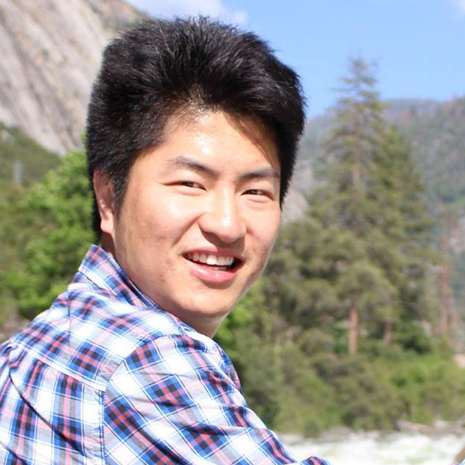
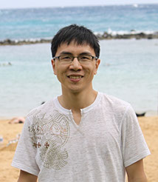
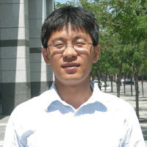
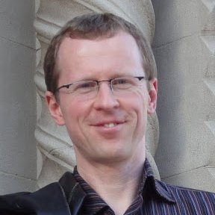
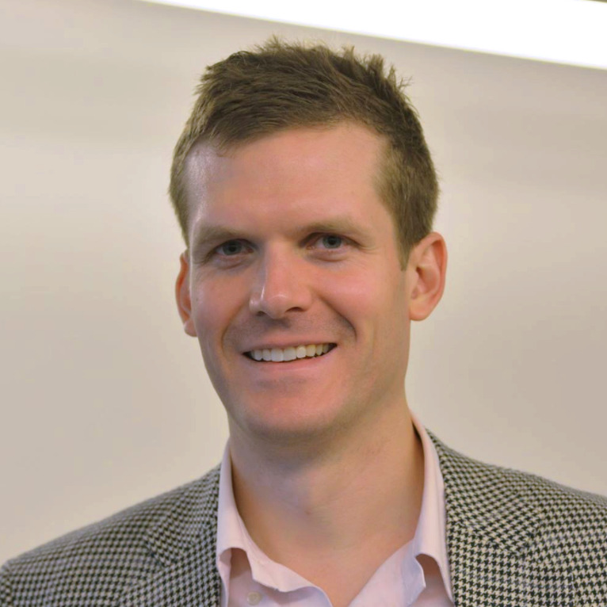
Learning to Detect Multiple Photographic Defects
Ning Yu
University of Virginia
Xiaohui Shen
Adobe Research
Zhe Lin
Adobe Research
Radomír Měch
Adobe Research
Connelly Barnes
University of Virginia
Adobe Research

Slide 2
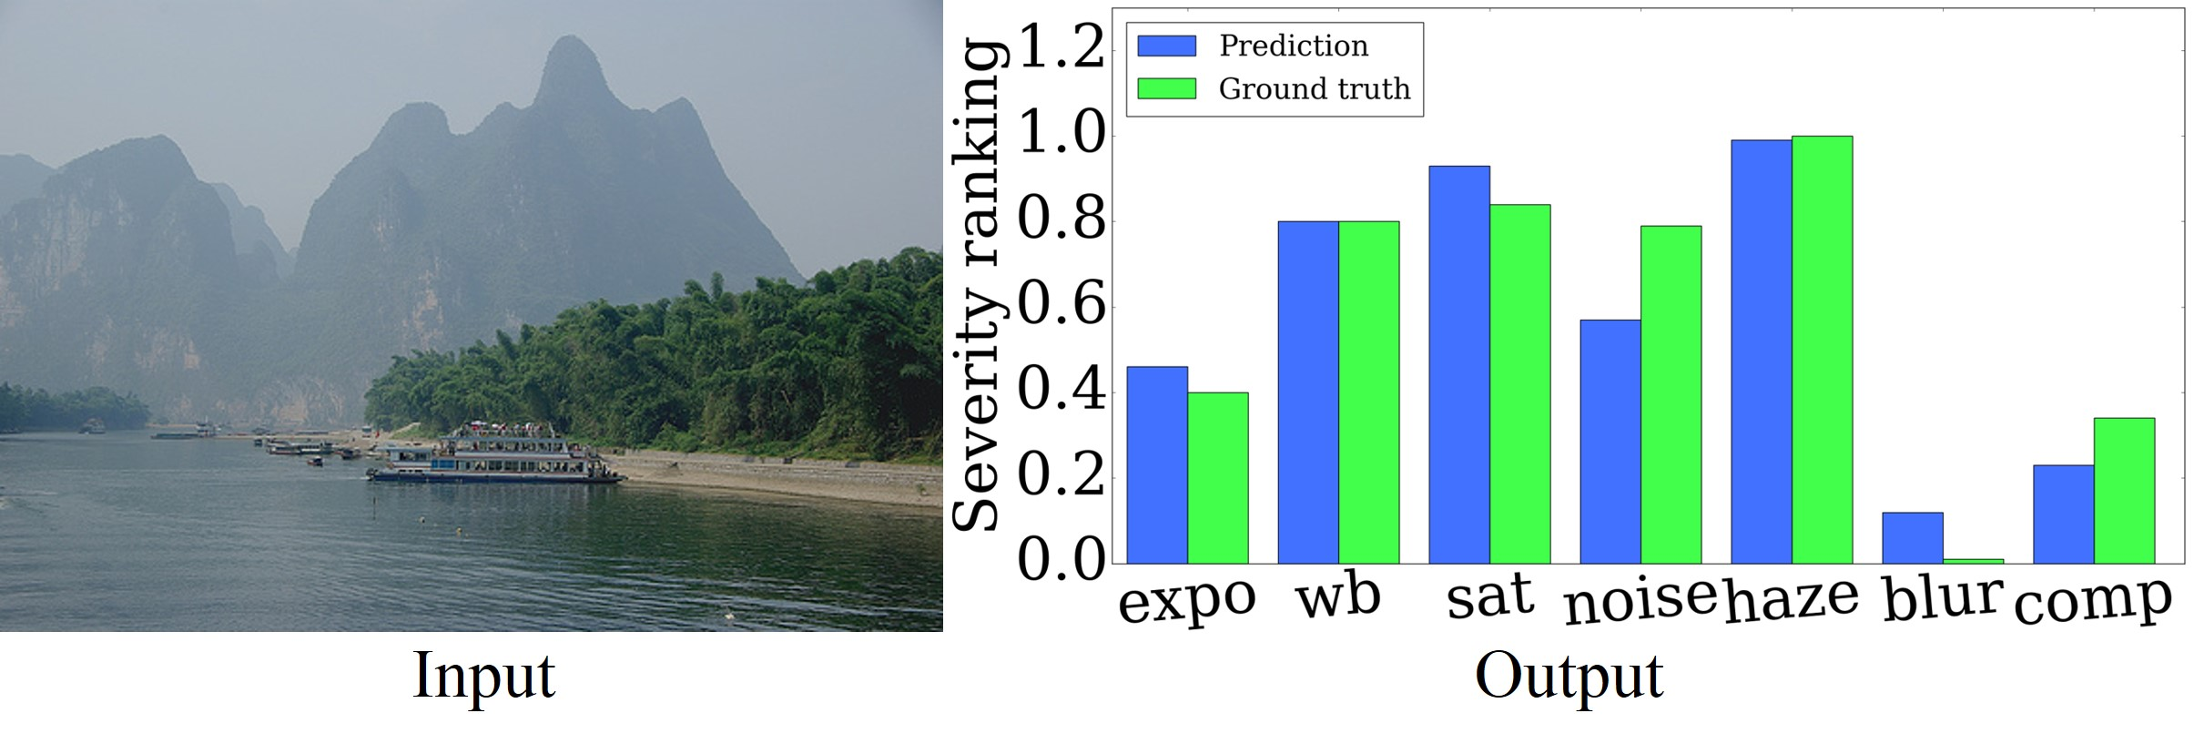
Output Quick Preview

Slide 3
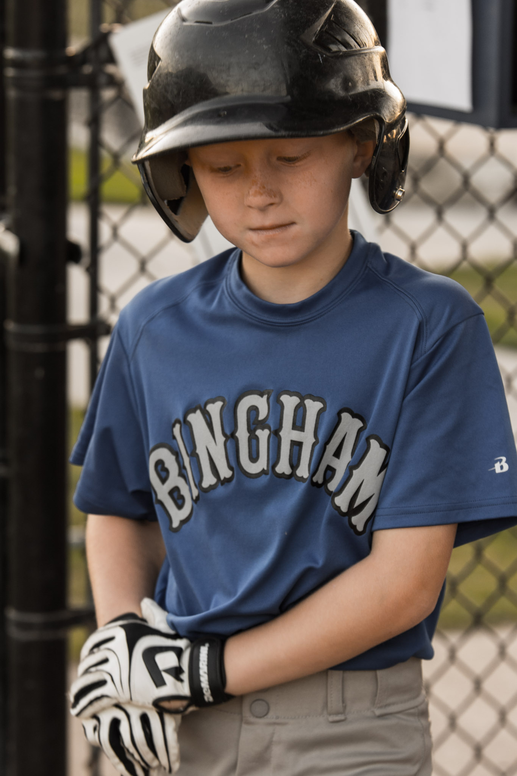




Motivation
For a casual Lightroom user
Defects Diagnosis
Tone Curve
Saturation Slider
Bad Exposure
Noise Reduction
Bad White Balance
Dehaze
Bad Saturation
Red Eye Correction
.
.
.
Auto Shake Reduction
.
.
.

Slide 4

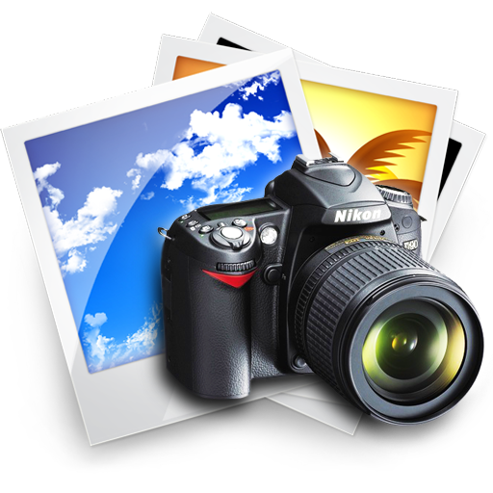
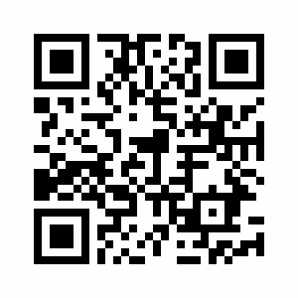
Contributions
A new problem: detecting 7 photographic defects
A new dataset: 12,853 images defect severity annotations
A deep-learning approach: multi-task, multi-scale
A shared project: dataset and code online:
https://github.com/ningyu1991/DefectDetection

Slide 5
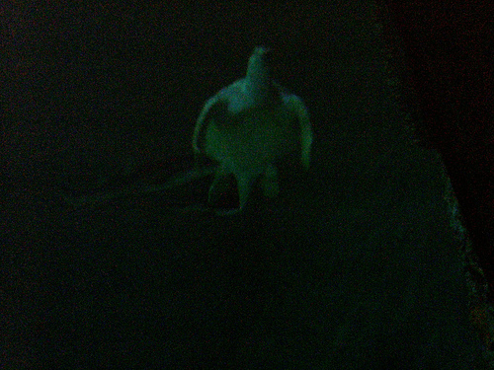
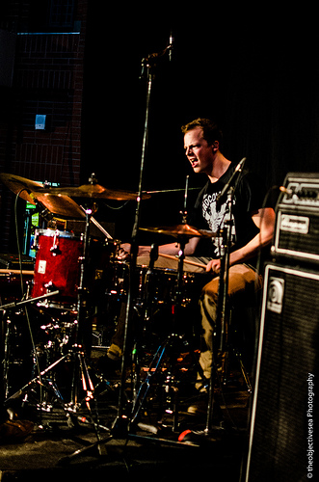
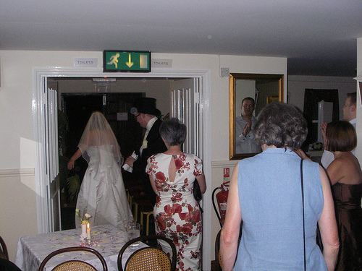
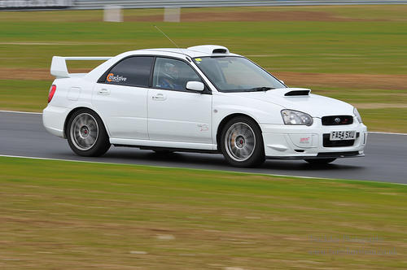
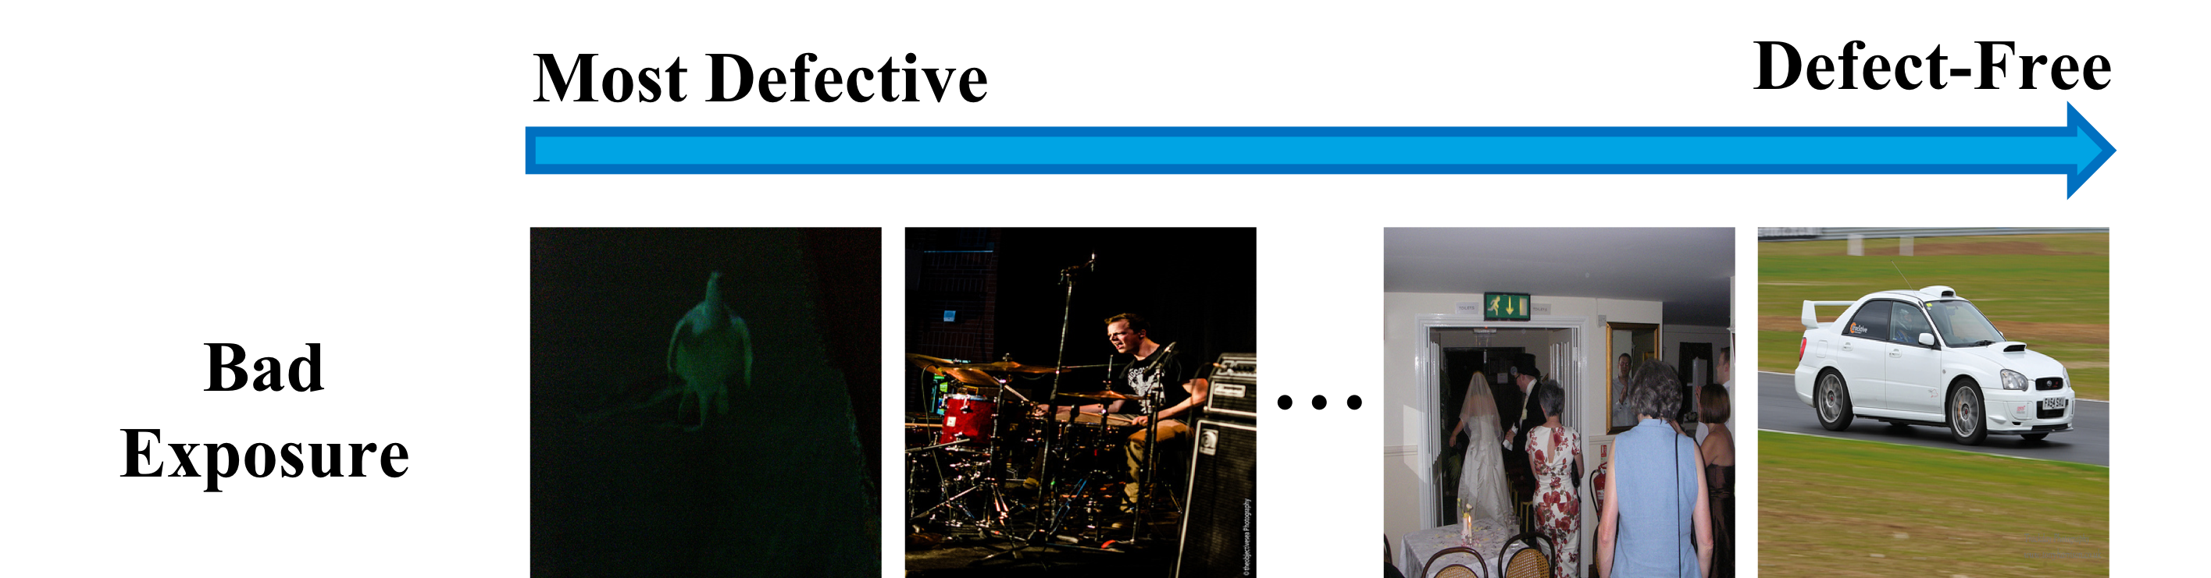
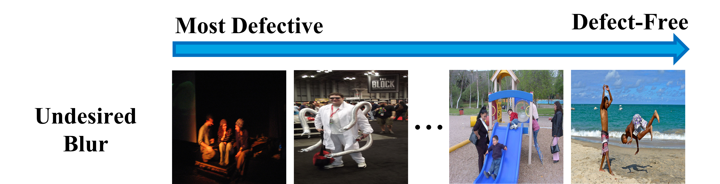

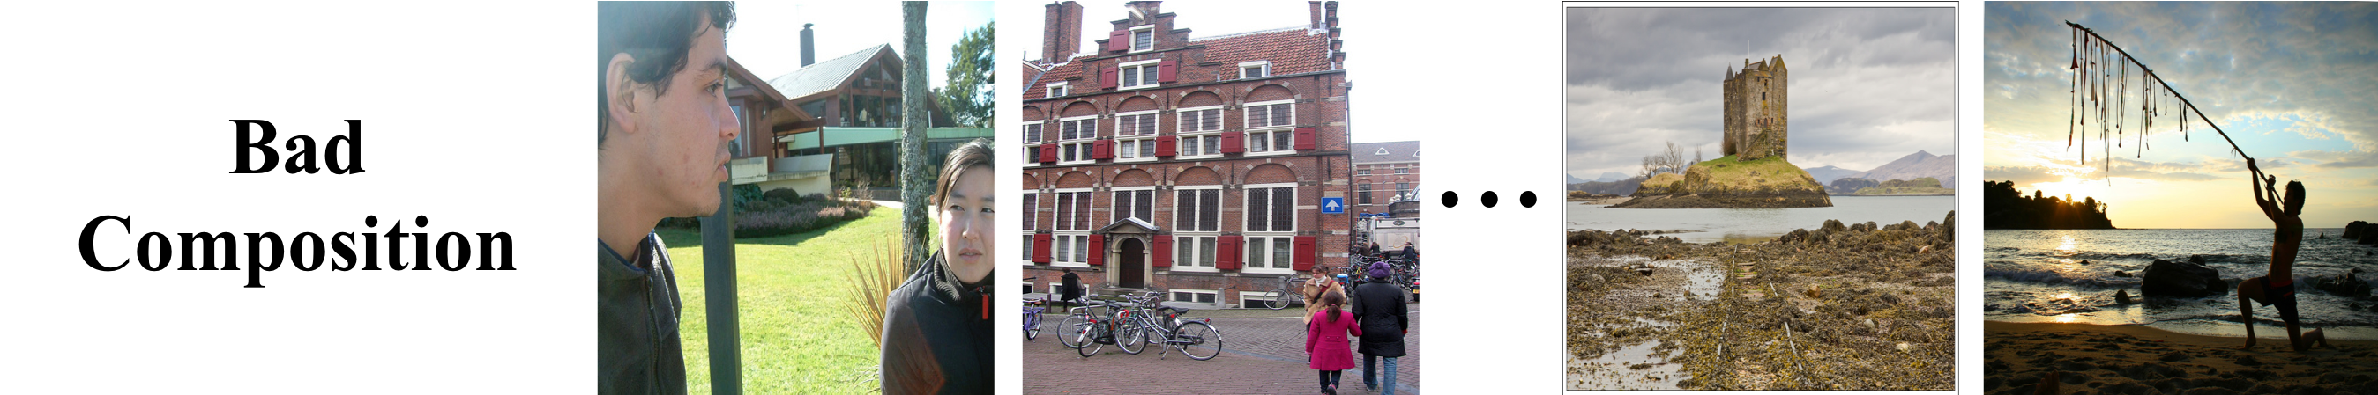
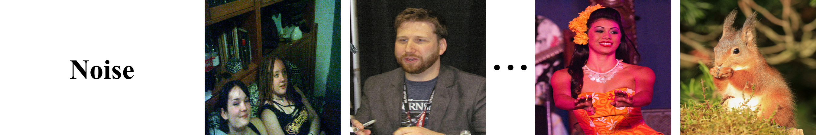
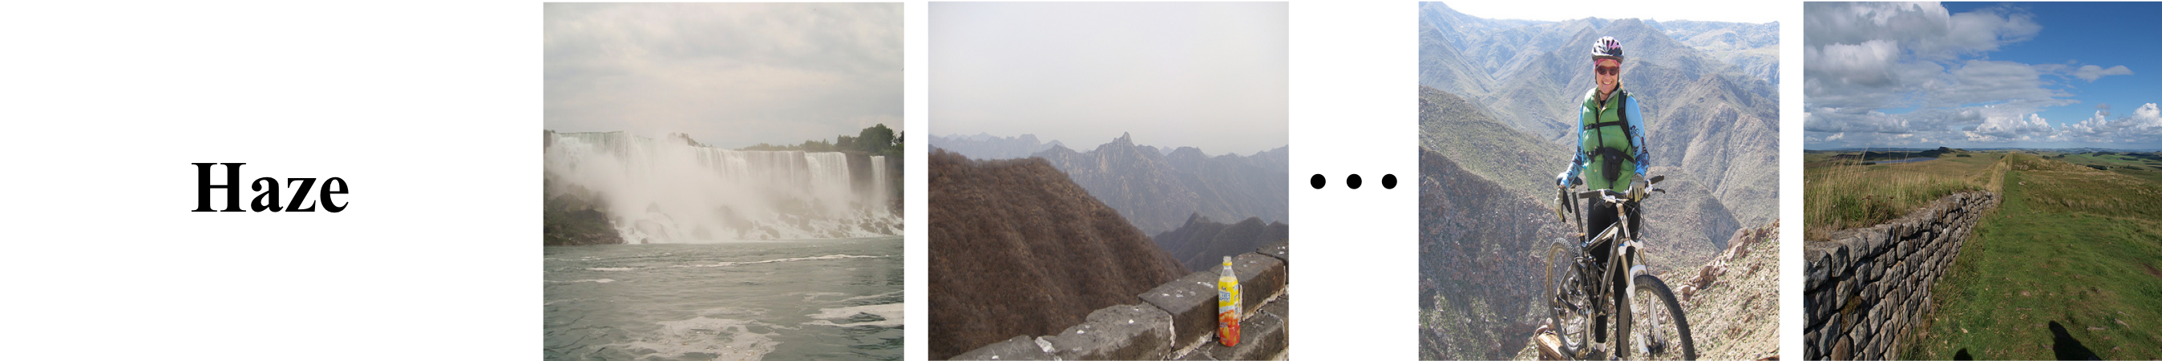
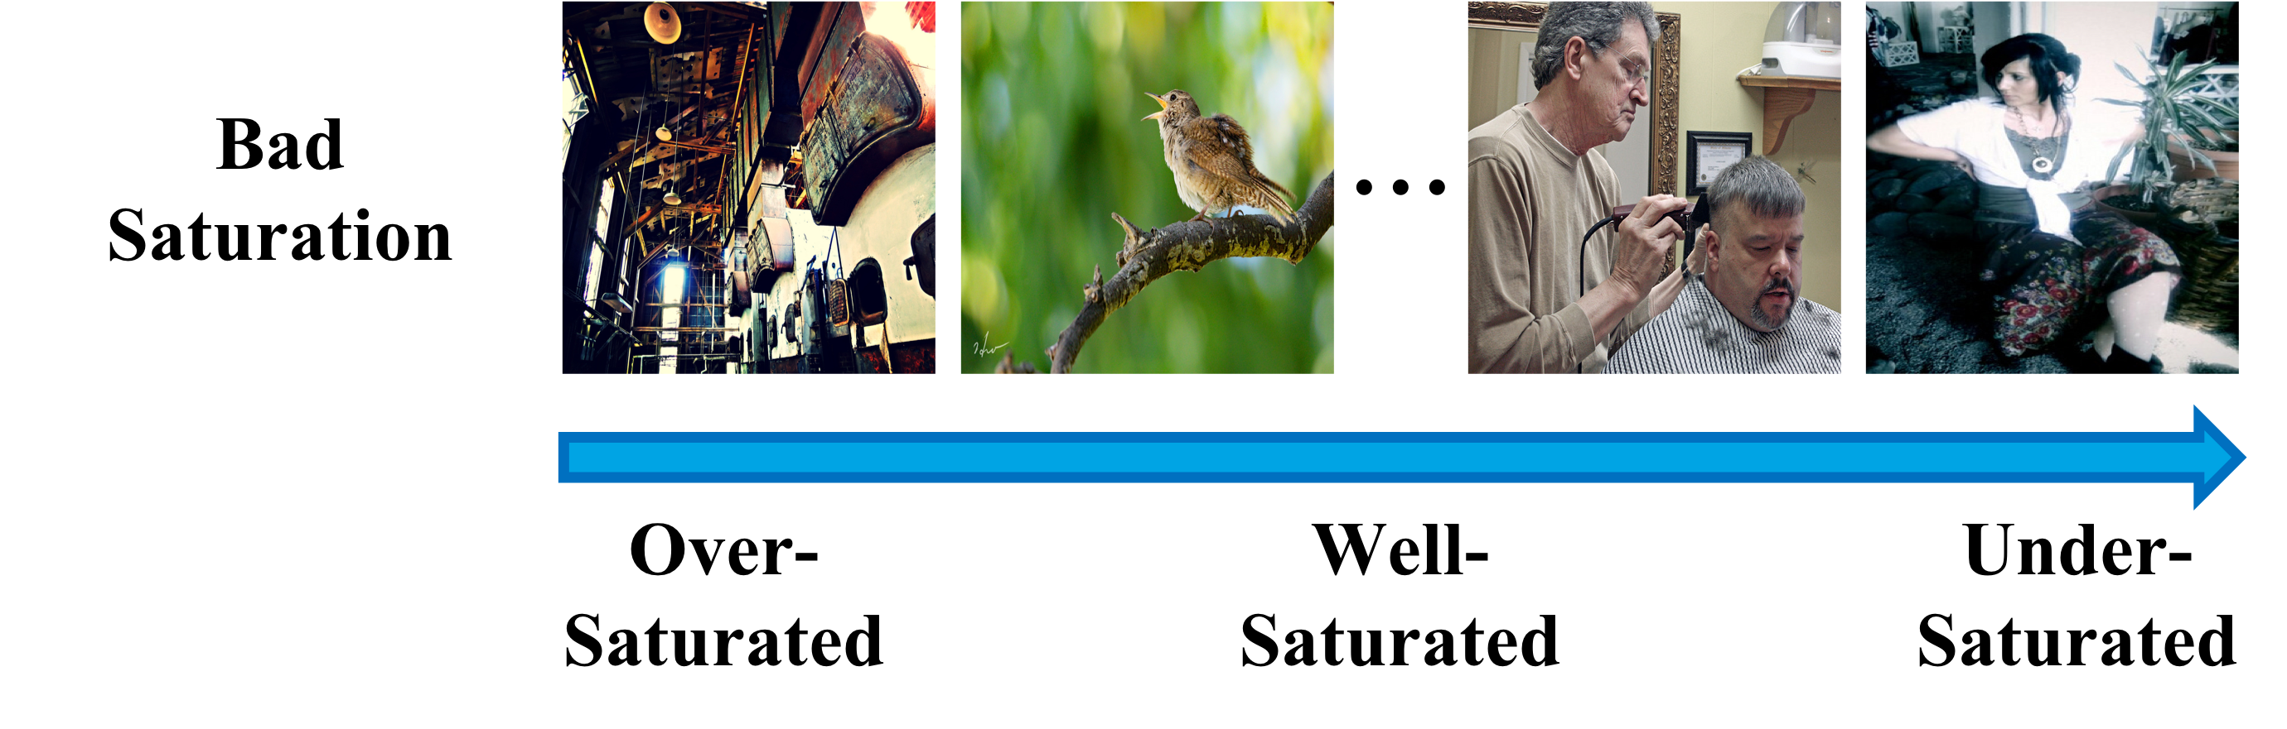
Defect Definition
Most Defective
Defect-Free
Bad
Exposure

Slide 6
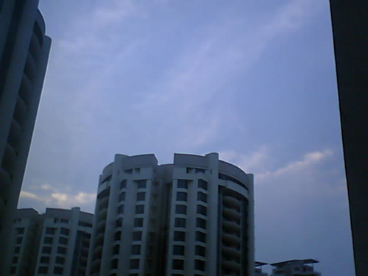
Data Collection

Slide 7
Data Collection
12,583 natural images from Flickr
7 defects per image
5 annotation votes per defect
449,855 annotations

Slide 8
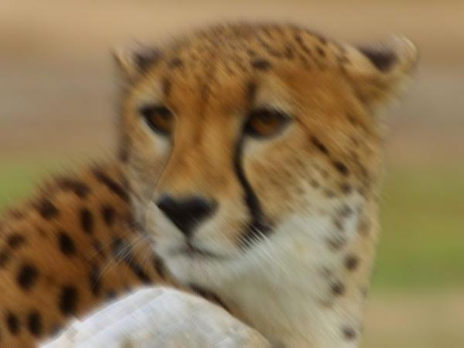
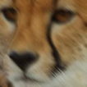
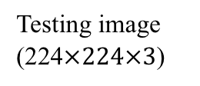
Network Architecture
The earlier 8 inceptions
of GoogLeNet
The later 2 inceptions
of GoogLeNet
Severity score for defect 1
fc (128)
Softmax
fc (11)
Testing image
(224$×224×3$)
Parameter sharing
The earlier 8 inceptions
of GoogLeNet
The later 2 inceptions
of GoogLeNet
Severity score for defect 7
fc (128)
Softmax
fc (11)

Slide 9
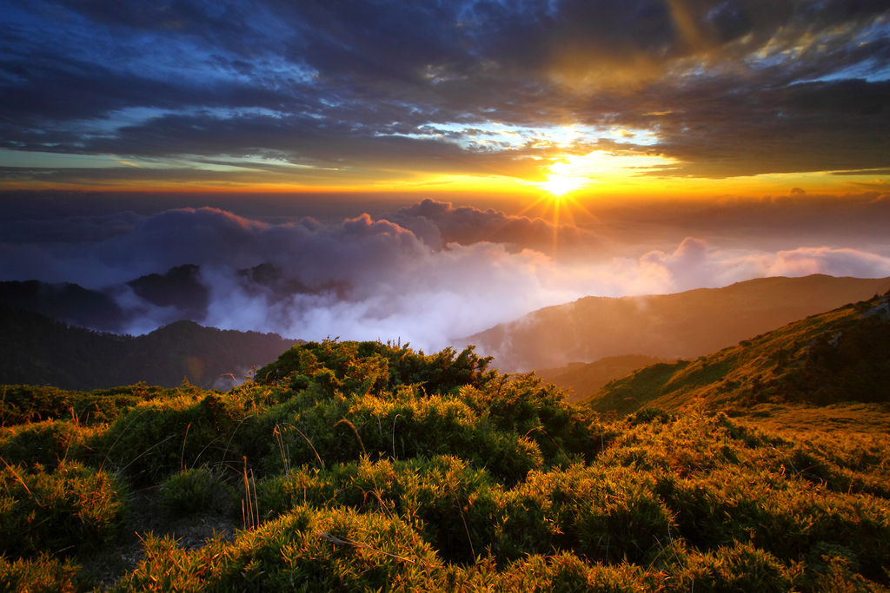
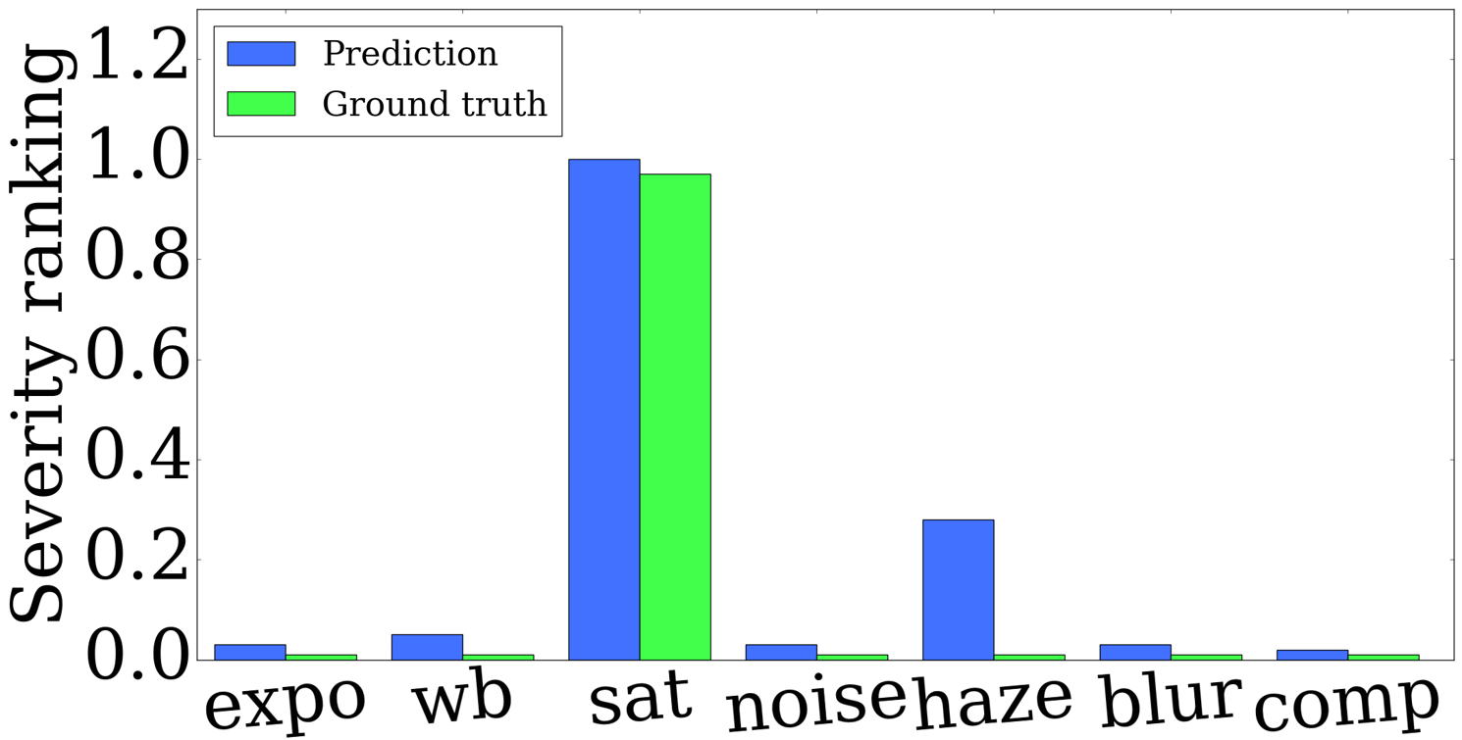
Experiment: Defect Severity Prediction
Input
Output

Slide 10
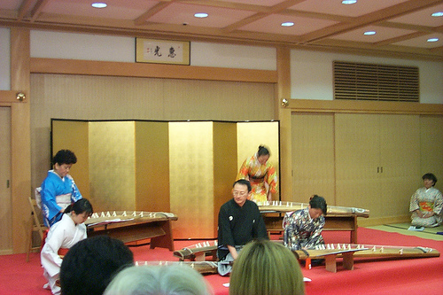
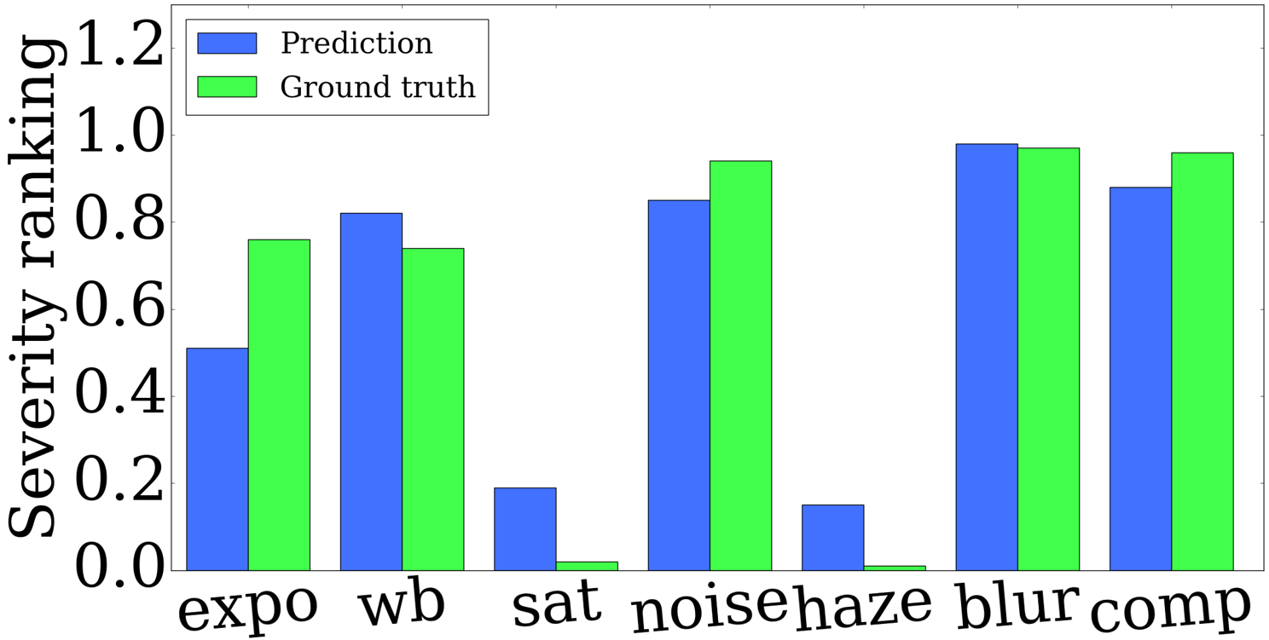
Experiment: Defect Severity Prediction
Input
Output

Slide 11
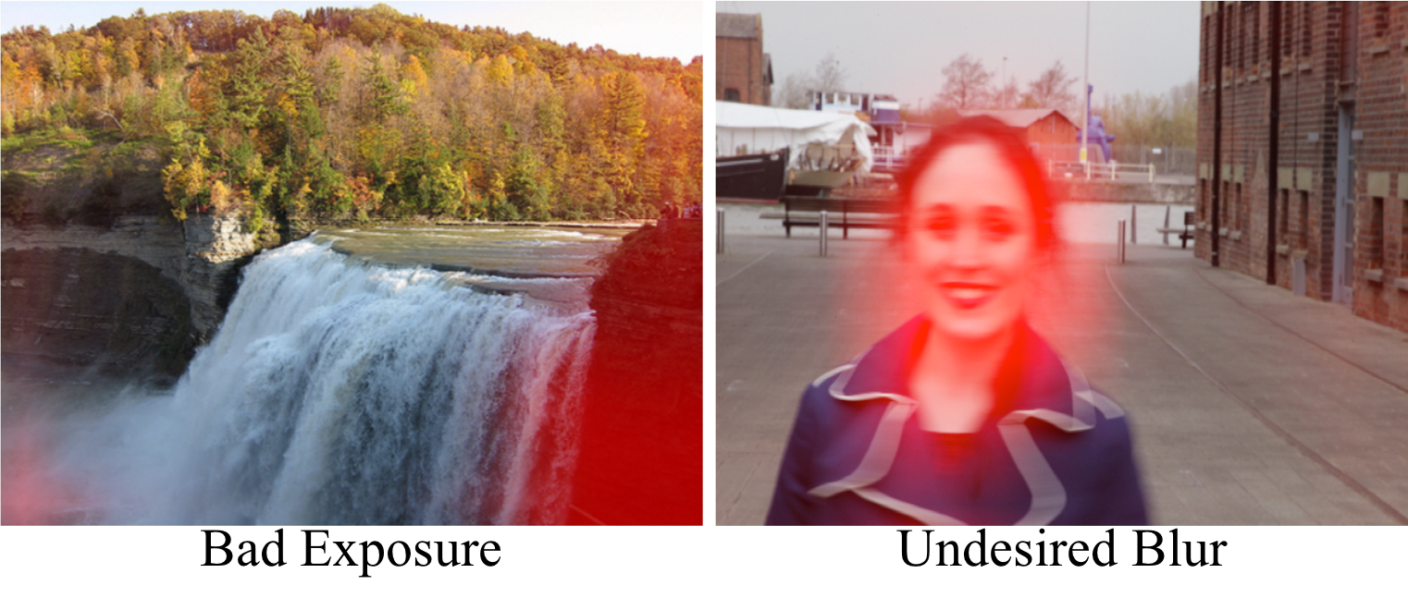
Experiment: Defect Severity Heatmap

Slide 12
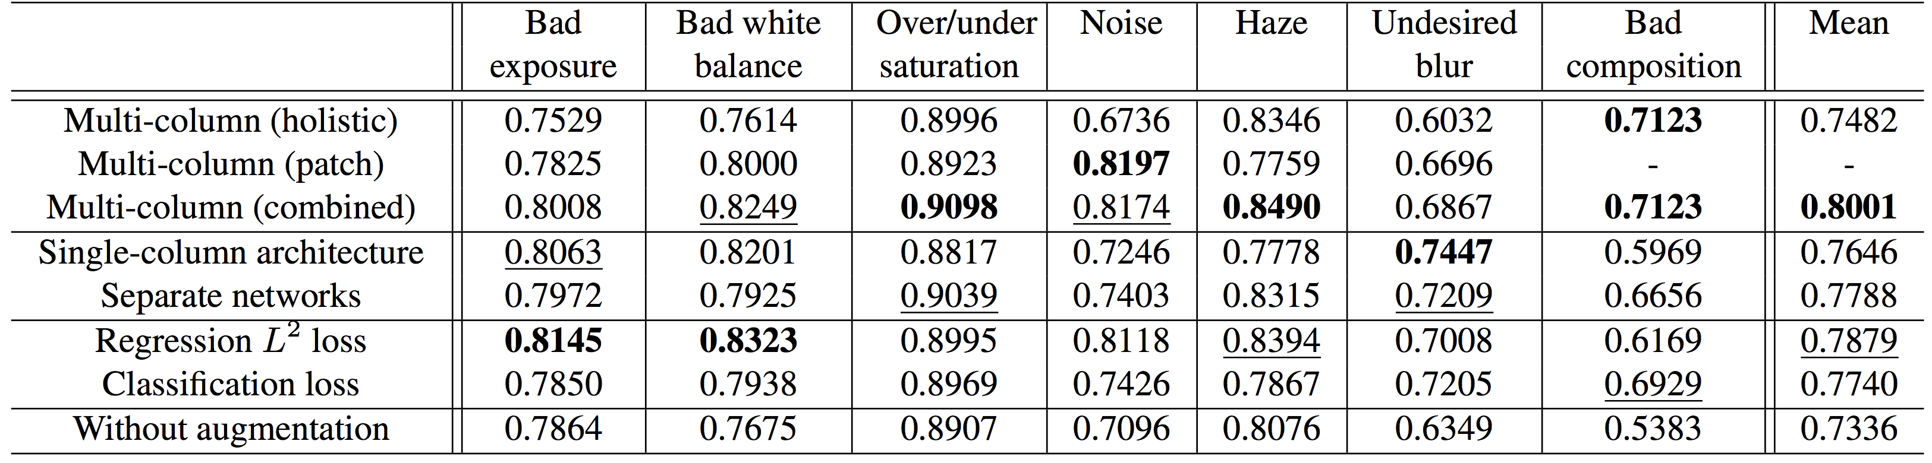
Experiment: Ablation Study

Slide 13
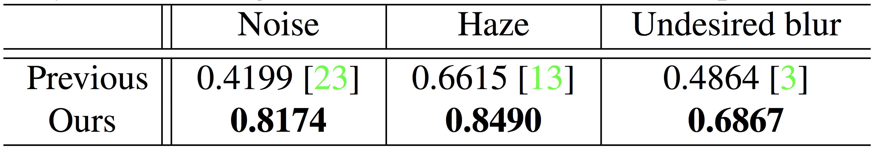
Experiment: Comparison to Previous Methods
Reference
[23] X. Liu, M. Tanaka, and M. Okutomi. Single-image noise level estimation for blind denoising. In IEEE TIP 2013.
[13] K. He, J. Sun, and X. Tang. Single image haze removal using dark channel prior. In IEEE TPAMI 2011.
[3] A. Chakrabarti, T. Zickler, and W. T. Freeman. Analyzing spatially-varying blur. In CVPR 2010.

Slide 14
Experiment: Acknowledgement
This research is supported by Adobe Research Funding.
We thank to the photographers for licensing photos under Creative Commons or public domain.
We benefit from caffe-googlenet-bn repository: https://github.com/lim0606/caffe-googlenet-bn

Slide 15
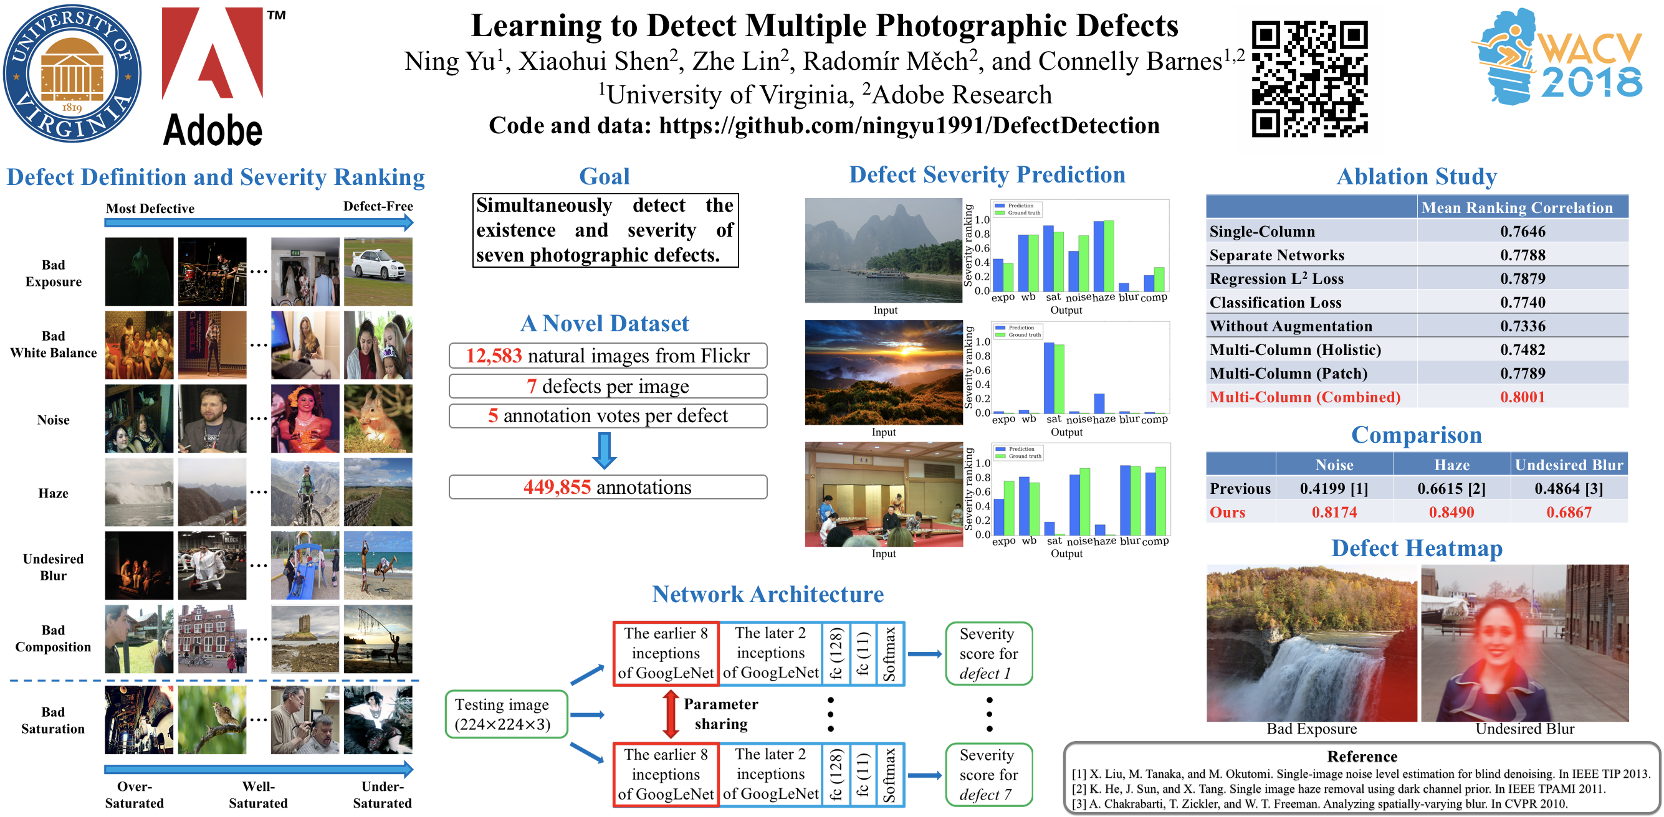
Q & A at My Poster Session (03/14 Wed 3A 63)

